Slide 1
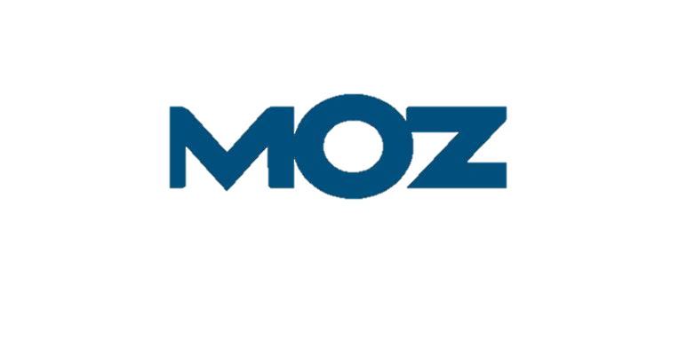
MOZ: Managing Growth Analysis
Audrey Bennett · Samin Bahizad · Ahdithan Uthayakumar
Current situation · Root causes · AFM Chapter 4 framework · Recommendation
Based on HBS Case 9-820-002 | Analysis for Financial Management, Chapter 4

Slide 2
01 / CURRENT SITUATION
How Moz Got Here
2000–06
2007
2011
2012–15
2016
Consulting;
$100K debt
First product;
$1.1M Series A
3rd profitable year;
$11.4M revenue
$18M Series B;
4 products in
4 years
$10M Series C;
all products
miss targets
The causal chain:
The $18M Series B in 2012 created pressure to grow. Fishkin, feeling obligated to justify investor expectations, bet on 'inbound marketer' becoming a standard role , a premise that did not occur. He launched 4 new products in 4 years, but each one subtracted from Pro's growth rather than adding new revenue. By mid-2016, every product missed projections simultaneously , leaving Moz with ~12 months of cash and no clear path forward.
August 2016 snapshot:
$40M projected revenue · 210 employees · $29.1M total VC raised · ~12 months of cash remaining
1

Slide 3
01 / CURRENT SITUATION
The Numbers: Burning Cash Faster Than Revenue Grows
Key Insight: Total Q1–Q3 2016: revenue $29.7M · operating loss −$8.7M · cash burn −$
2
Source: Moz Case Study

Slide 4
02 / ROOT CAUSE DIAGNOSIS
What Went Wrong, And Could It Have Been Avoided?
1
Flawed market assumption
2
Actual growth exceeded sustainable growth
Management bet on an 'inbound marketer' role that never materialized. Channel specialists stayed specialized and preferred best-of-breed tools, Moz’s all-in-one suite found no buyers.
Headcount grew 68% (125 to 210) while revenue grew only 21% ($31.3M to ~$38M). New products were funded by burning cash, not organic profits, a textbook case of growth outpacing financial resources.
3
Bad growth, not good growth
4
Operational overextension
Each new product missed projections and subtracted from Pro’s growth. Per AFM Ch. 4, investments earning returns below cost of capital are bad growth, they destroy value even as revenue rises.
Running 8 products left every team understaffed. Also, the Local’s cash flow was misunderstood: costs were paid immediately at signup while revenue arrived monthly, a structural drain that caught management by surprise.
Could this have been avoided? Yes. Pro forma forecasting (AFM Ch. 3–4) would have revealed actual growth far exceeding the sustainable growth rate, a signal to prune, not expand. The cross-sell thesis could have been tested cheaply before committing to four full product launches.
3

Slide 5
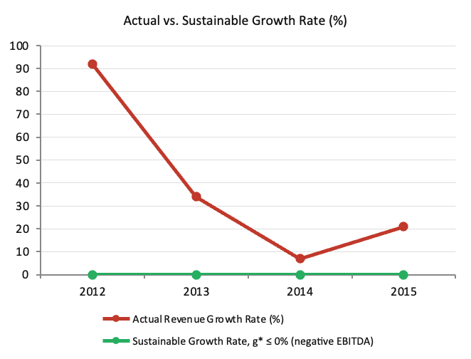
03 / MANAGING GROWTH
Applying the Sustainable Growth Framework
g* ≤ 0% because Moz had negative EBITDA every year.
Any positive revenue growth required burning external cash. g* = P × R × A × T̂; negative P means zero capacity for self-funded growth.
4

Slide 6
04 / RECOMMENDATION
Refocus on SEO Core: Shut Down and Divest New Products
Option A ✗
Option B ✓
Double down on new products
Shut down Content, sell Followerwonk, retain Pro + Local
—
No product-market fit after years of effort, the ‘inbound marketer’ thesis proved false
—
Pro is the proven core, 23,132 paying subscribers with strong SEO brand equity
—
Selling or milking Pro removes the only profitable revenue engine
—
Local has a differentiated recurring revenue model worth preserving and fixing
—
AFM: bad growth wastes resources even when it appears as revenue on paper
—
AFM Ch. 4: prune marginal activities when actual growth exceeds sustainable growth
—
Cross-sell disproven: <5% of Pro subscribers used Followerwonk monthly
—
Pruning 8 → 2 products restores team depth, engineering quality, and marketing focus
—
12-month runway cannot support further experimentation
—
Sale of Followerwonk and wind-down of Content extend the cash runway
—
Competitors at $40–$80M revenue show SEO-focused tools can scale without diversification
5

Slide 7
04 / RECOMMENDATION
Next Steps — Path to Sustainable Growth
Immediate (0–30 days)
Near-term (30–90 days)
Medium-term (90–365 days)
1
Wind down Moz Content; initiate sale process for Followerwonk
1
Redirect engineering talent into Moz Pro improvements
1
Drive Pro growth toward 25,000+ paying subscribers
2
Targeted layoffs; communicate transparently per TAGFEE values
2
Fix Local’s cash flow model: align cost timing with revenue receipts
2
Improve P and A (the levers of g*) to raise sustainable growth rate
3
Freeze all new hiring across every division
3
Reduce cost of revenue — target gross margin improvement
3
Reach operating profitability before any new product investment
4
Stabilize cash runway — preserve remaining 12 months
4
Renegotiate VC covenants to reflect focused strategy
4
Reassess capital needs once core business is stabilized
Source: AFM Ch. 4
6

Slide 8
CONCLUSION
The Road to Sustainable Growth
How they got here
Moz pursued 4 products in 4 years on the false premise that ‘inbound marketer’ would become a standard role. VC-backed growth pressure compounded the mistake. Every product missed projections simultaneously.
Our Current Situation
The sustainable growth rate (g* = P × R × A × T̂) is a ceiling. When actual growth exceeds it, companies can literally grow broke. Moz’s $12M cash burn in 2013 on $29.3M revenue is the model in action.
Our recommendation
Shut down Content, sell Followerwonk, refocus on Moz Pro and Local. AFM prescribes pruning marginal activities when actual growth exceeds sustainable growth — the financially sound choice most consistent with Moz’s competitive strength.
The path forward
Improve profit margin and asset efficiency — the operational levers of g* — to raise sustainable growth from within. Profitability must precede any future expansion. Moz’s brand in SEO remains a durable asset.
7

Slide 9
REFERENCES
References
Eisenmann, Thomas. “Rand Fishkin at Moz (A).” Case 9-820-002. Harvard Business School, 2019. Revised March 21, 2023.
Higgins, Robert C., Jennifer L. Koski, and Todd Mitton. Analysis for Financial Management. 13th ed. New York: McGraw-Hill, 2022.
Higgins, Robert C. “Sustainable Growth under Inflation.” Financial Management 10, no. 3 (Autumn 1981): 36–40.
8

